Slide 1
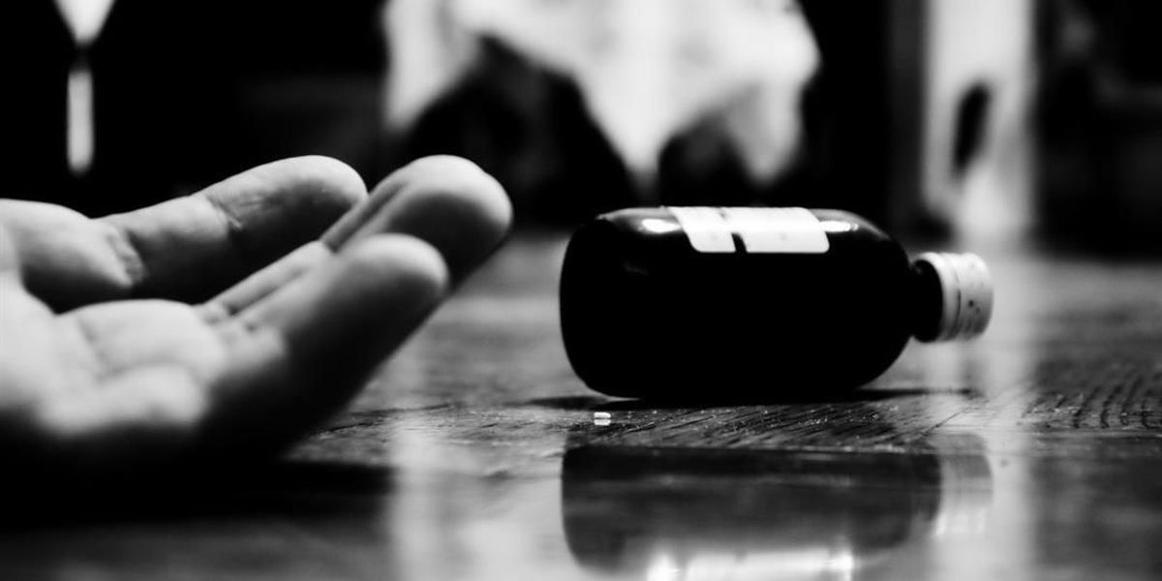
Suicides in India (2001-2012)
MySQL Project

Slide 2
Table of Content
About the Dataset
Objectives
Analysis
Key Findings
Final Message

Slide 3
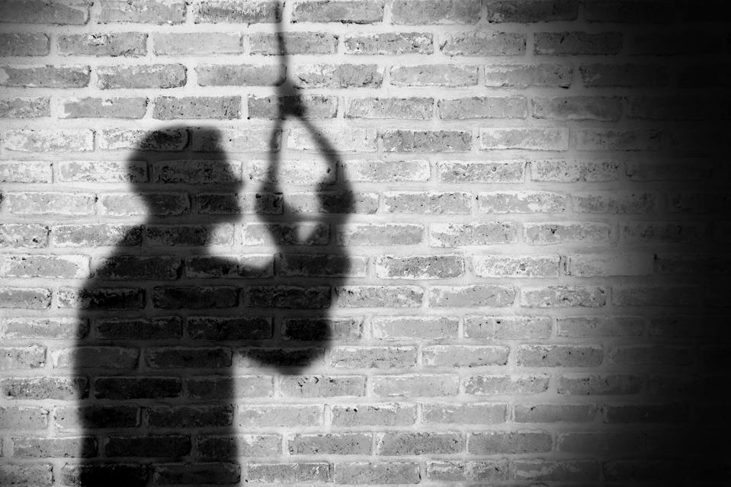
About the Dataset
Twelve Years of Data Total Seven Columns
State → States in India
Year → Suicide Year
Type_code → Type of Suicide
Type → Details about the Suicide
Gender → Male or Female
Age_group → The Age Group of
the Person who Committed Suicide
Total → Total Deaths

Slide 4
Objectives
Male Vs Female Ratio of Deaths from 2001 to 2012
Top 5 States in terms of Total Deaths
Male Vs Female Ratio of Deaths For Love Affairs
Students Death Records in the Last 5 Years
Males and Females Percentage of Death rate for Job Issue
State & Year-wise Domestic Problems Cases for Female
Which Age group Generally Hang Themselves
Top 5 States where Social Abuse is the Primary Cause of Suicide

Slide 5
Objectives (Cont.)
Males and Females Percentage of Deaths for a Family Problem
Year and State wise Suicide happened for Education Cases
Top 3 Reasons for Suicide for Male and Female
Age group and State-wise Suicide happened for Male due to Addiction
Males and Females Ratio of Mental Illness Suicide Cases
Top 5 States and Percentage of Deaths for Relationship Suicide Cases
State and Year-wise Deaths for Sudden Mental Trauma
State-wise Ratio of Deaths for Educated Students

Slide 6
Year-wise Male Vs Female Ratio of Deaths
1.6 to 1.9
Male

Slide 7
Top 5 States in terms of Total Deaths
Maharashtra
West Bengal
Tamil Nadu
Andhra Pradesh
Karnataka

Slide 8
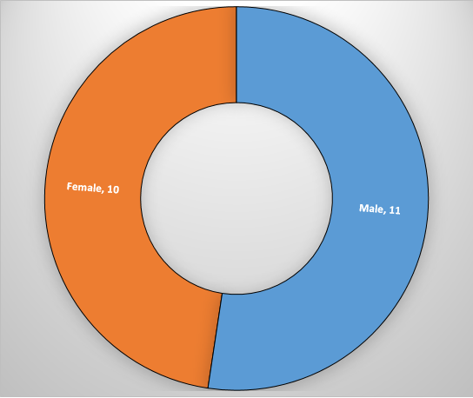
The Ratio of Deaths For Love Affairs
Male : Female = 11: 10
Male = 23700
Female = 21339
Maximum Probability: Male

Slide 9
Students Death Records in the Last 5 Years
2011 → 7696

Slide 10
Percentage of Death rate for Job Issue
Unemployment and Unemployed
Exact percentage:
Male = 82.86%, Female = 17.14%

Slide 11
State & Year-wise Domestic Problems Cases (Female)
State-wise
Year-wise

Slide 12
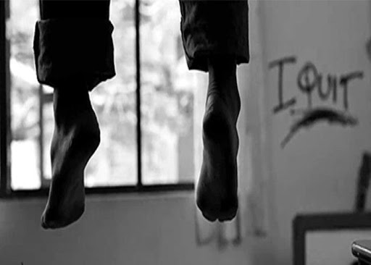
Which Age group Generally Hang Themselves
15-29

Slide 13

Top 5 States where Social Abuse is the Primary Cause of Suicide
Rape cases
Madhya Pradesh
Maharashtra
Chhattisgarh
Uttar Pradesh
Gujarat

Slide 14
The Percentage of Deaths for a Family Problem
Male = 62.96%
Female = 37.04%
Family problem, Property, and Poverty

Slide 15
Year and State wise Suicide happened for Education Cases
Year wise
State wise

Slide 16
Top 3 Reasons for Suicide
Male
Female

Slide 17
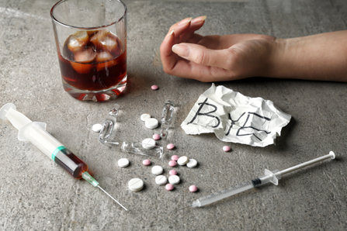
Age group and State-wise Suicide for Male due to Addiction
Age group wise
State wise

Slide 18
The Ratio of Mental Illness Suicide Cases
Male : Female = 9:5

Slide 19

Top 5 States and Percentage of Deaths for Relationship Suicide Cases
15-44 age group
Love affairs, Divorce, Divorcee
Andhra Pradesh
Maharashtra
Gujarat
Odisha
Madhya Pradesh

Slide 20
State and Year-wise Deaths for Sudden Mental Trauma
State-wise
Year-wise

Slide 21
State-wise Ratio of Deaths for Educated Students
Graduate and Above
Graduate, Post Graduate, and Diploma
Manipur → 6:1

Slide 22

Key Findings
Suicide rate: Male > Female
In 2012, the ratio of Deaths was high
15-29 age group has maximum Probability
Maximum Suicide happened in Maharashtra
Love Affairs, Male: Female = 11:10
34550 Students were died in the last 5 years (Year-wise: 2011)
Job Issue, Male committed Suicide more often

Slide 23
Key Findings (Cont.)
Maximum Domestic Problem cases: Maharashtra (Year-wise: 2011)
15-29 age group often Hang themselves
Madhya Pradesh is on top of Social Abuse
In Family problem, Male > Female
Maximum Education Cases: West Bengal
30-44 age group is for Addiction cases (Maharashtra is on Top)

Slide 24
Key Findings (Cont.)
Married: Common reason for Male and Female
Mental illness, Male : Female = 9:5
The Maximum percentage of Relationship Cases: Andhra Pradesh
Sudden Mental Trauma: 316896 deaths
Maximum Sudden Mental Trauma cases: Maharashtra (Year-wise: 2012)
Maximum Ratio for Educated Students: Manipur (Male: Female=6: 1)

Slide 25
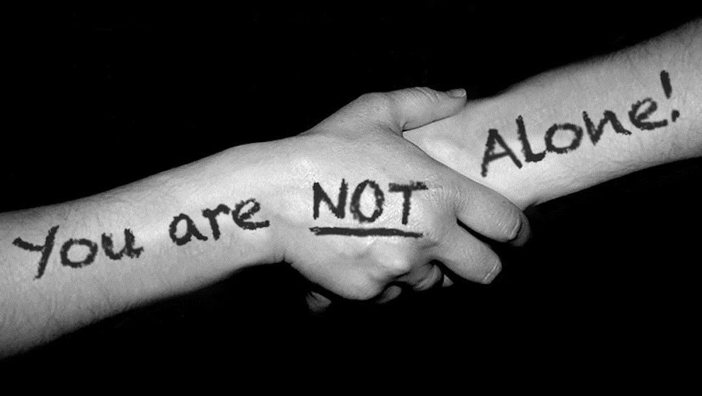

Slide 26


